Slide 1
Predictive Maintenance for Industrial Equipment
ELL409
Project 10

Slide 2
Ayush Singh 2021MT10899
Aditya Thomas 2021MT60944
Priyal Jain 2021MT60949
Team 1729

Slide 3
Introduction
Predictive maintenance minimizes downtime by predicting failures before they occur, surpassing the inefficiencies of traditional reactive and preventive approaches.
Leveraging machine learning and sensor data, this project develops a model to predict failures in turbofan engines using the NASA C-MAPSS dataset.
The study covers data analysis, feature engineering, and advanced machine learning techniques, addressing challenges like noisy data and model interpretability to enhance industrial reliability and efficiency.
Notes:
Predictive maintenance aims to minimize downtime by predicting equipment failures before they happen, offering an advantage over traditional reactive or preventive maintenance approaches. In this project, we leveraged machine learning and sensor data to predict failures in turbofan engines using the NASA C-MAPSS dataset. The work covers data analysis, feature engineering, and advanced machine learning techniques, tackling challenges such as noisy data and model interpretability to ultimately improve industrial reliability and efficiency.

Slide 4
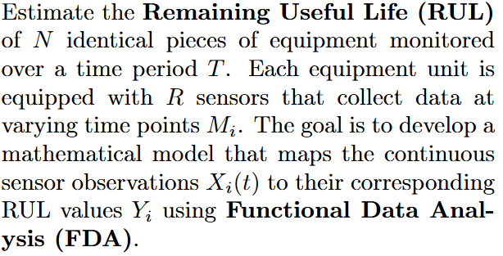
Problem Statement
Notes:
Industrial equipment, especially in critical sectors like aviation, manufacturing, and energy, requires reliable maintenance strategies to ensure uninterrupted operations. However, traditional maintenance approaches face significant limitations:
Challenges with Existing Maintenance Approaches:
Reactive Maintenance: This method involves addressing failures after they occur, leading to unplanned downtime, higher repair costs, and potential safety risks.
Preventive Maintenance: While this approach schedules maintenance activities at regular intervals, it often leads to unnecessary repairs and does not account for the actual condition of the equipment.
Need for Predictive Maintenance:
Predictive maintenance addresses the drawbacks of these methods by using sensor data and advanced algorithms to predict when equipment will fail.
The goal is to act proactively, reducing downtime, avoiding unnecessary repairs, and ensuring safety and efficiency.
Problem Context - Turbofan Engines:
Turbofan engines are complex and expensive machinery critical to aviation and other industries.
Failure to accurately predict their degradation can result in costly repairs, flight delays, or catastrophic failures.
The varying operational conditions and fault modes add to the challenge, making a one-size-fits-all maintenance solution impractical.
Technical Challenges:
Noisy Data: Sensor readings often contain noise, making it difficult to extract meaningful patterns for failure prediction.
High-Dimensional Data: With numerous sensors and operational variables, the dataset requires effective feature selection and preprocessing to avoid overwhelming the model with irrelevant information.
Interpretable Predictions: Maintenance teams require not just accurate predictions but also insights into why a model predicts failure, adding another layer of complexity.
Key Objective: The project aims to develop a predictive maintenance model that can accurately estimate the Remaining Useful Life (RUL) of turbofan engines. The model must:
Generalize across different operating conditions and fault modes.
Handle noisy and high-dimensional data effectively.
Provide actionable insights to support industrial decision-making.
Impact of Solving This Problem:
By addressing these challenges, the solution will significantly reduce downtime, optimize maintenance schedules, and enhance equipment reliability.
In industries like aviation, it can improve safety, lower costs, and increase customer satisfaction by preventing unexpected failures.

Slide 5
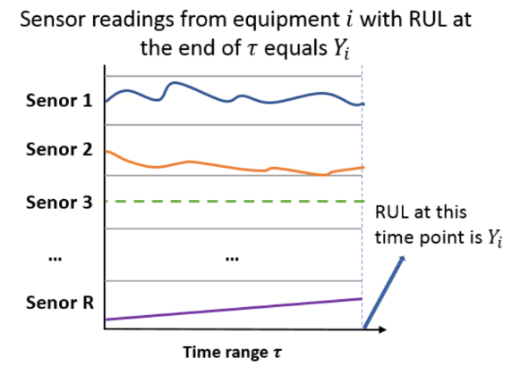
Problem Statement
Notes:
Industrial equipment, especially in critical sectors like aviation, manufacturing, and energy, requires reliable maintenance strategies to ensure uninterrupted operations. However, traditional maintenance approaches face significant limitations:
Challenges with Existing Maintenance Approaches:
Reactive Maintenance: This method involves addressing failures after they occur, leading to unplanned downtime, higher repair costs, and potential safety risks.
Preventive Maintenance: While this approach schedules maintenance activities at regular intervals, it often leads to unnecessary repairs and does not account for the actual condition of the equipment.
Need for Predictive Maintenance:
Predictive maintenance addresses the drawbacks of these methods by using sensor data and advanced algorithms to predict when equipment will fail.
The goal is to act proactively, reducing downtime, avoiding unnecessary repairs, and ensuring safety and efficiency.
Problem Context - Turbofan Engines:
Turbofan engines are complex and expensive machinery critical to aviation and other industries.
Failure to accurately predict their degradation can result in costly repairs, flight delays, or catastrophic failures.
The varying operational conditions and fault modes add to the challenge, making a one-size-fits-all maintenance solution impractical.
Technical Challenges:
Noisy Data: Sensor readings often contain noise, making it difficult to extract meaningful patterns for failure prediction.
High-Dimensional Data: With numerous sensors and operational variables, the dataset requires effective feature selection and preprocessing to avoid overwhelming the model with irrelevant information.
Interpretable Predictions: Maintenance teams require not just accurate predictions but also insights into why a model predicts failure, adding another layer of complexity.
Key Objective: The project aims to develop a predictive maintenance model that can accurately estimate the Remaining Useful Life (RUL) of turbofan engines. The model must:
Generalize across different operating conditions and fault modes.
Handle noisy and high-dimensional data effectively.
Provide actionable insights to support industrial decision-making.
Impact of Solving This Problem:
By addressing these challenges, the solution will significantly reduce downtime, optimize maintenance schedules, and enhance equipment reliability.
In industries like aviation, it can improve safety, lower costs, and increase customer satisfaction by preventing unexpected failures.

Slide 6
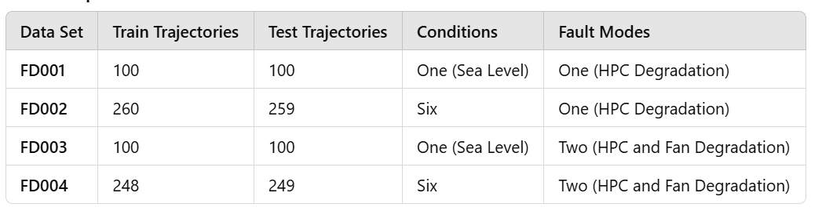
DataSet Description
Notes:
The NASA C-MAPSS dataset was used in this project to simulate the degradation behavior of turbofan engines. It is one of the most widely used datasets for research on predictive maintenance due to its detailed simulation of real-world conditions. Here's a breakdown of its key features:
Purpose of the Dataset:
The dataset simulates turbofan engine degradation over time under different operating conditions.
It is specifically designed to support research on prognostics, such as predicting Remaining Useful Life (RUL).
Dataset Structure:
The dataset contains four subsets (FD001, FD002, FD003, FD004), each representing different operational settings and fault modes.
Each subset has:
Operational settings: Variables like altitude, air pressure, and temperature that influence engine performance.
Sensor measurements: Data from 21 sensors monitoring various engine parameters, such as temperature, pressure, and vibration. These sensors capture the engine's health and degradation patterns.
Training vs. Testing Data:
Training Data: Captures the degradation history of engines from a healthy state until failure. This is used to train the machine learning model.
Testing Data: Consists of engines in operation up to a certain point, where the RUL needs to be predicted by the model. This evaluates the model's accuracy.
Challenges in the Dataset:
Noisy Data: The sensor readings are not perfectly clean and contain noise that can obscure the degradation trends.
High Dimensionality: With 21 sensors and multiple operational settings, the dataset is large and complex, requiring careful preprocessing to extract meaningful features.
Varying Operating Conditions: Each subset has different combinations of operating conditions, making the problem more challenging and realistic.
Importance of the Dataset:
It provides a comprehensive simulation of engine degradation under diverse scenarios, making it ideal for testing and comparing predictive models.
The variability in fault modes and conditions closely mimics real-world industrial environments, ensuring the relevance of the project outcomes.
Link to the Problem Statement: By utilizing this dataset, we aimed to create a model capable of generalizing across different operational settings and accurately predicting the Remaining Useful Life of engines, thereby addressing the industry's critical need for reliable predictive maintenance solutions.

Slide 7
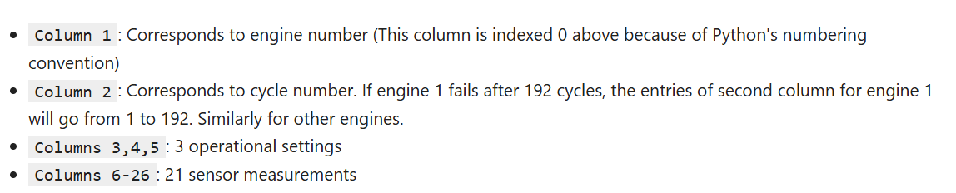
DataSet Description
Notes:
The NASA C-MAPSS dataset was used in this project to simulate the degradation behavior of turbofan engines. It is one of the most widely used datasets for research on predictive maintenance due to its detailed simulation of real-world conditions. Here's a breakdown of its key features:
Purpose of the Dataset:
The dataset simulates turbofan engine degradation over time under different operating conditions.
It is specifically designed to support research on prognostics, such as predicting Remaining Useful Life (RUL).
Dataset Structure:
The dataset contains four subsets (FD001, FD002, FD003, FD004), each representing different operational settings and fault modes.
Each subset has:
Operational settings: Variables like altitude, air pressure, and temperature that influence engine performance.
Sensor measurements: Data from 21 sensors monitoring various engine parameters, such as temperature, pressure, and vibration. These sensors capture the engine's health and degradation patterns.
Training vs. Testing Data:
Training Data: Captures the degradation history of engines from a healthy state until failure. This is used to train the machine learning model.
Testing Data: Consists of engines in operation up to a certain point, where the RUL needs to be predicted by the model. This evaluates the model's accuracy.
Challenges in the Dataset:
Noisy Data: The sensor readings are not perfectly clean and contain noise that can obscure the degradation trends.
High Dimensionality: With 21 sensors and multiple operational settings, the dataset is large and complex, requiring careful preprocessing to extract meaningful features.
Varying Operating Conditions: Each subset has different combinations of operating conditions, making the problem more challenging and realistic.
Importance of the Dataset:
It provides a comprehensive simulation of engine degradation under diverse scenarios, making it ideal for testing and comparing predictive models.
The variability in fault modes and conditions closely mimics real-world industrial environments, ensuring the relevance of the project outcomes.
Link to the Problem Statement: By utilizing this dataset, we aimed to create a model capable of generalizing across different operational settings and accurately predicting the Remaining Useful Life of engines, thereby addressing the industry's critical need for reliable predictive maintenance solutions.

Slide 8
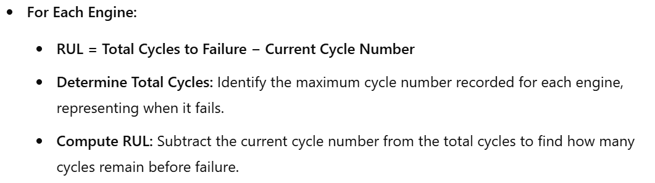
Calculation of RUL - Train Data
Notes:
Remaining Useful Life (RUL) is a crucial metric in predictive maintenance as it provides an estimate of how long a machine or component can continue functioning before failure.
For Training Data: We analyzed the trends between sensor readings and RUL. Specific sensors showed strong correlations with the degradation patterns of the engine. By leveraging these relationships, we created a mapping between the sensor data and the remaining life of the engine, enabling the model to "learn" what failure patterns look like.
For Test Data: Once the model was trained, it predicted RUL values for unseen data. This process involved applying the learned relationships from the training phase and comparing them against actual test results to evaluate the model's performance.

Slide 9
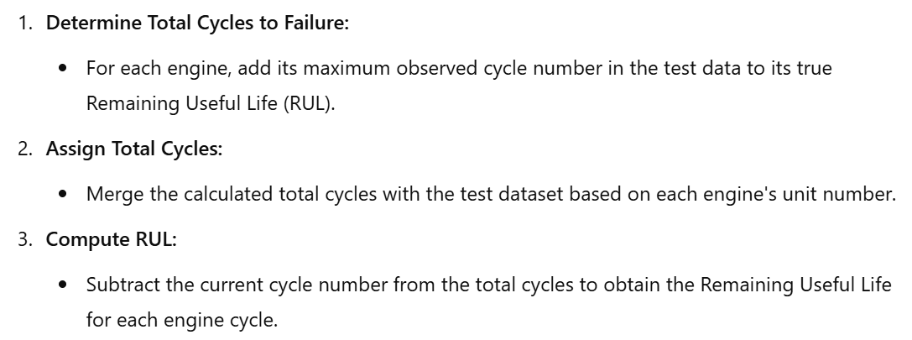
Calculation of RUL - Test Data
Notes:
Observing these trends helped refine our understanding of how specific sensor readings evolve as the equipment nears failure. This understanding was vital for constructing an accurate predictive framework.

Slide 10
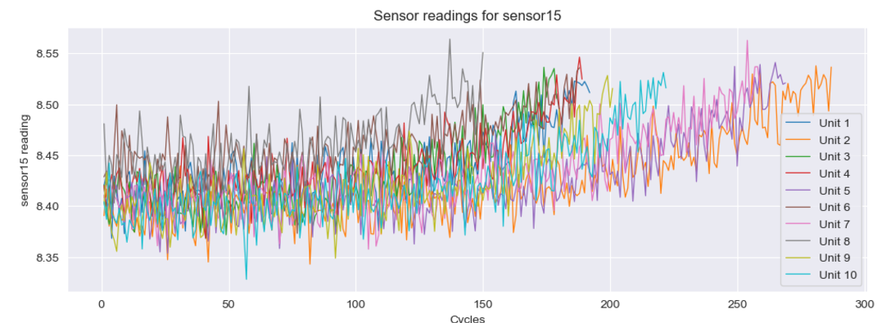
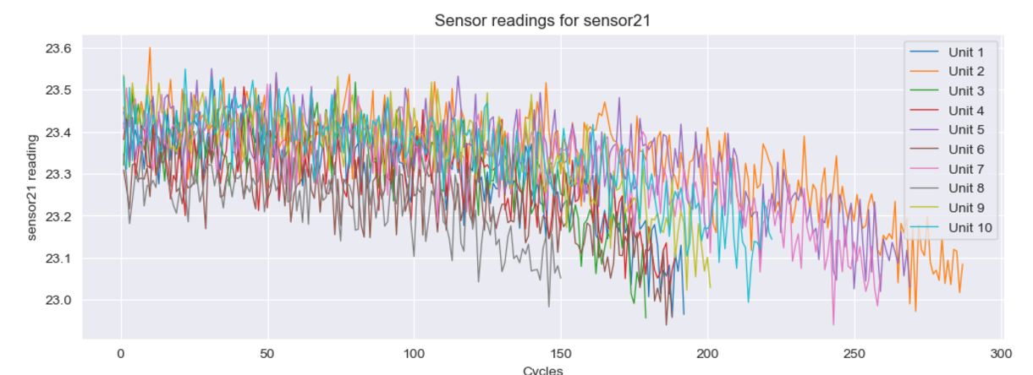
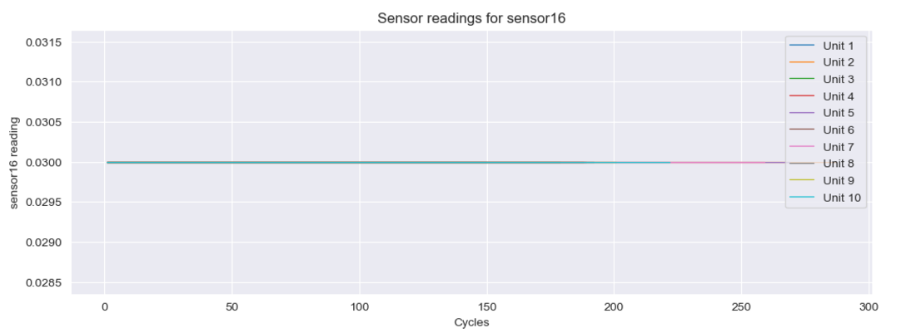
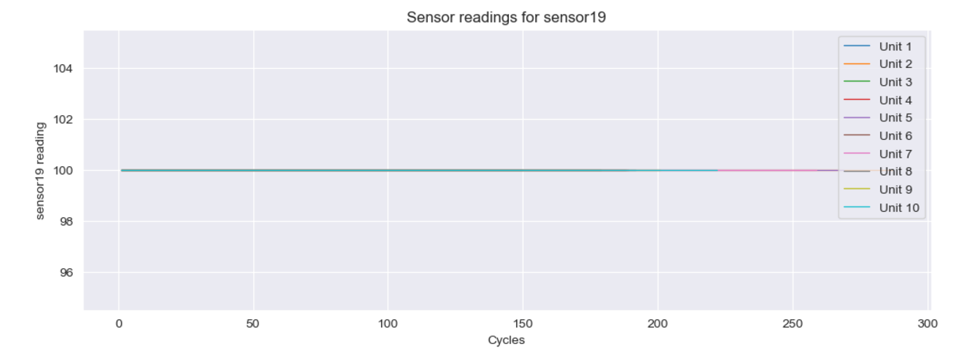
Data Pre-Processing
Trend between sensor readings and RUL was observed for all the sensors.
Notes:
We observed the sensor reading vs rul plot for all the sensors and observed that some columns had very low standard deviation which shows that the values are roughly constant. Constant values do not have much importance when we are dealing with time series data. Hence these columns were dropped.

Slide 11
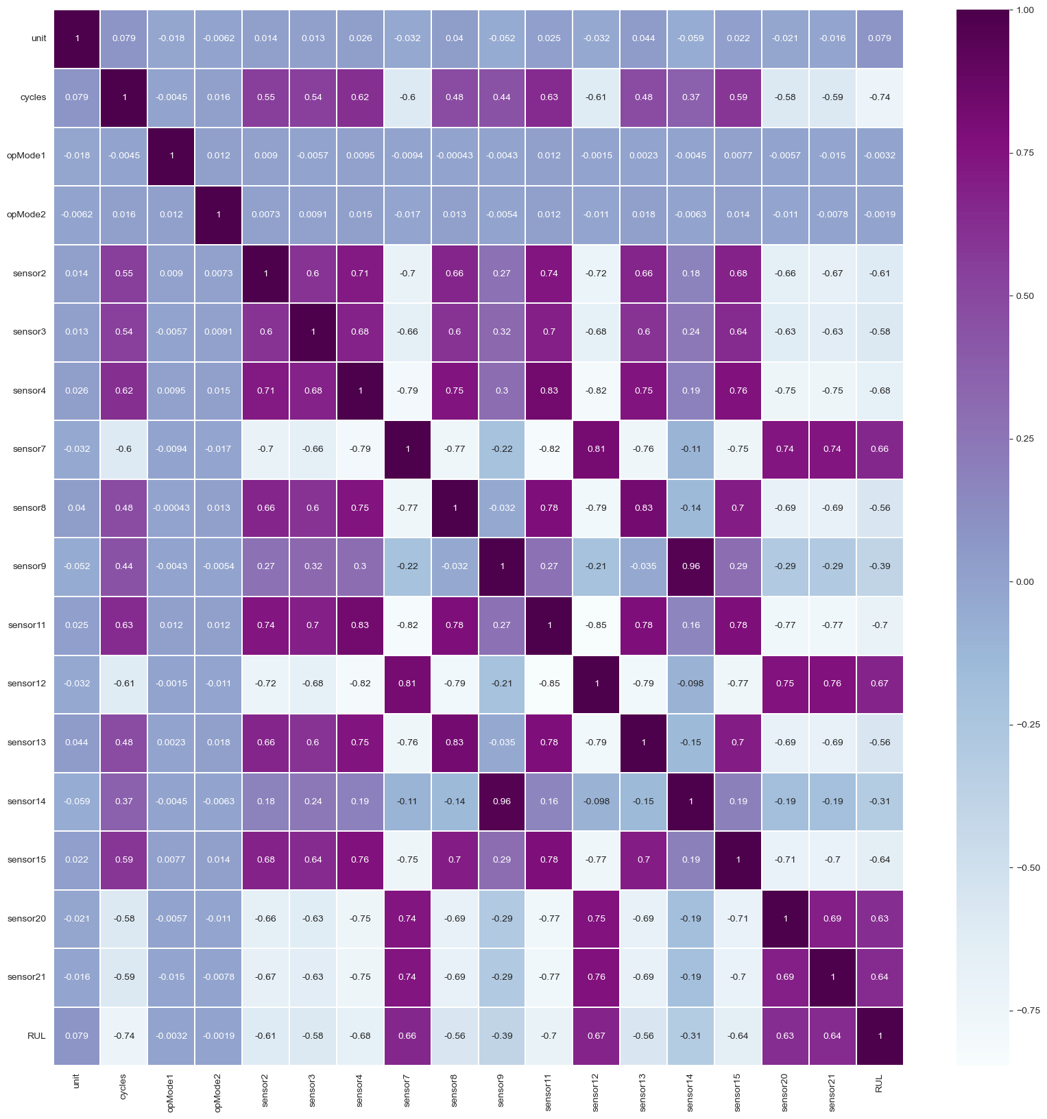
Data Pre-Processing
By utilizing a heatmap, we observed that certain sensors exhibited high correlation with one another. To reduce redundancy and improve data quality, we removed one of the highly correlated sensors.
Notes:
By utilizing a heatmap, we observed that certain sensors exhibited high correlation with one another. To reduce redundancy and improve data quality, we removed one of the highly correlated sensors.As we can see here, sensor 9 and sensor 14 are highly correlated.

Slide 12
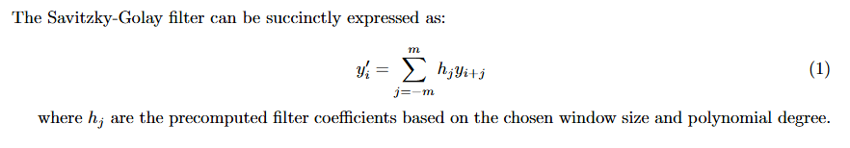
Savitzky-Golay Filter for Data Smoothing
The Savitzky-Golay filter is a digital filtering method that smooths noisy data while preserving important features like trends and peaks. It achieves this by fitting a low-degree polynomial to a moving window of data points and replacing each point with the polynomial's central value.
Notes:
Since the dataset is extremely noisy, the Savitzky-Golay filter was employed to enhance data clarity. This is a digital filtering method that smooths noisy data while preserving important features like trends and peaks. A quadratic polynomial was fitted to a moving window of data points and the window length was tailored to the number of cycles, respecting the data's periodic nature.
Benefits
Noise Reduction: Minimizes random fluctuations in the data.
Feature Preservation: Maintains important characteristics like peaks and trends.
Adaptability: Window length tailored to the number of cycles, respecting the data's periodic nature.

Slide 13
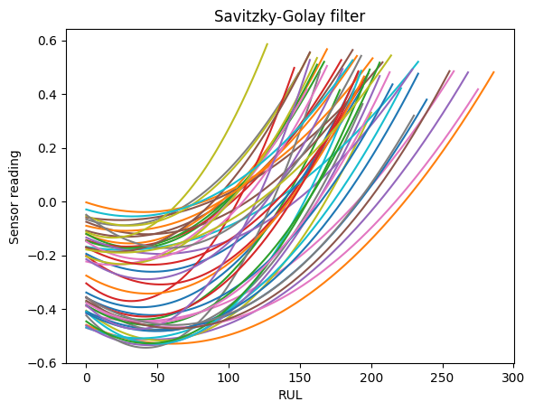
Notes:
After applying the filter, this is how the sensor reading vs rul plot looks like for sensor 15 as compared to how it looked before (skip to prev slide)

Slide 14
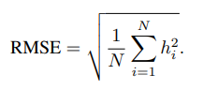
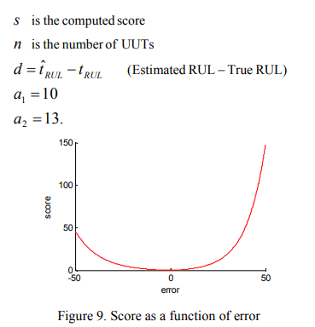
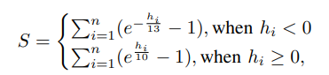
RMSE
S-score
Notes:
We used 2 metrics. One is simple root mean square but we faced a challenge that for an engine degradation scenario, an early prediction which informs us about failure before time should be preferred over late predictions. So we used another metric called s-score which penalizes late predictions more heavily than early predictions.

Slide 15
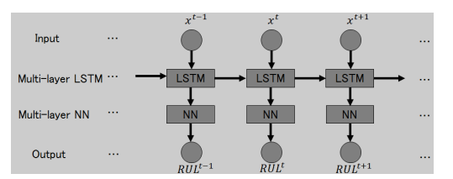
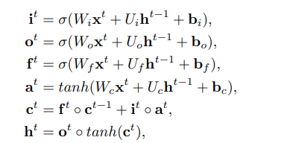
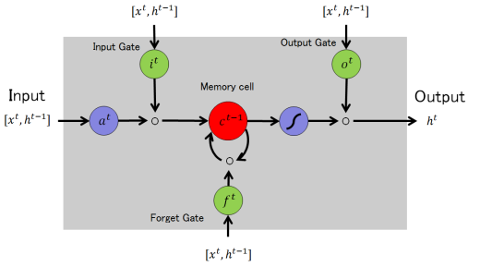
LSTM (advanced model)

Slide 16
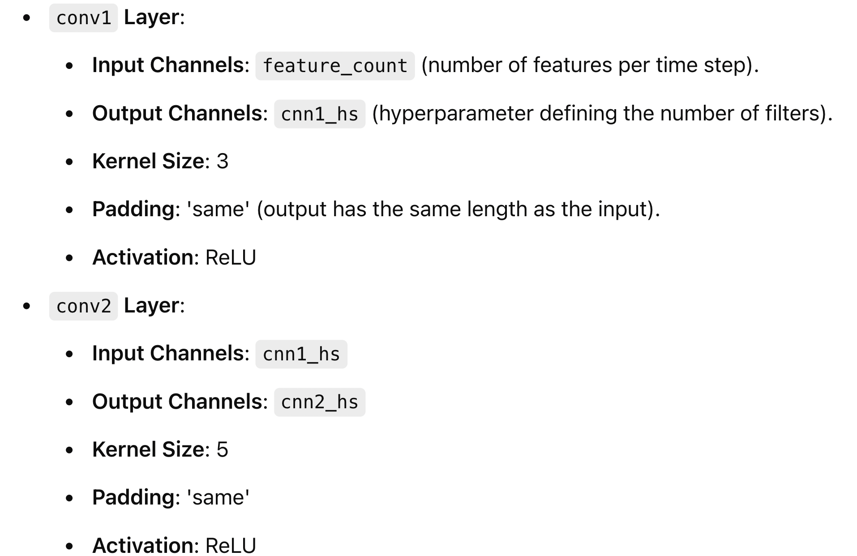
LSTM Architecture Used
Capture local temporal patterns and features within the sequences.
Reduce noise and highlight important features through convolution and pooling.

Slide 17
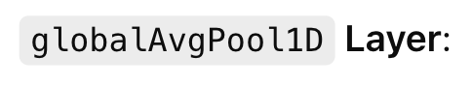
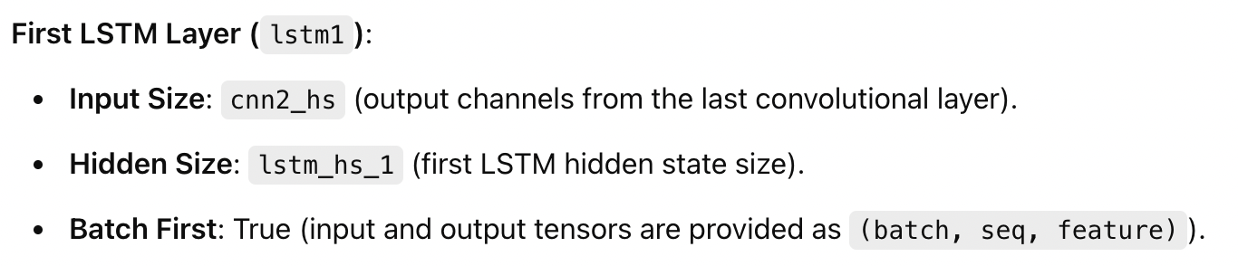
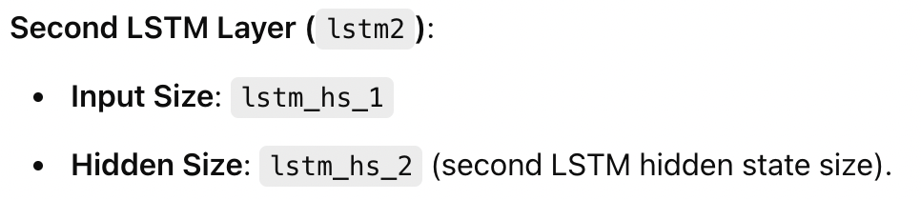
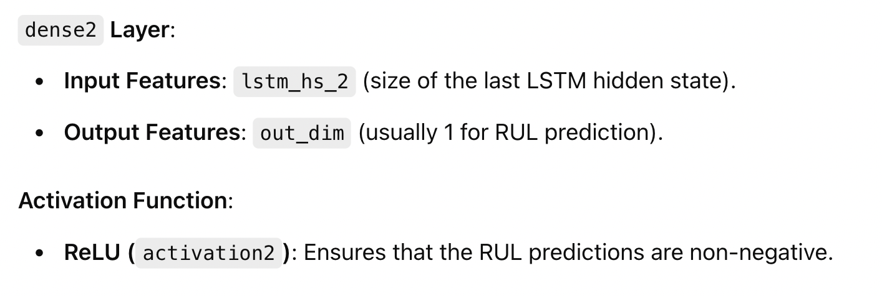
Applies average pooling over the time dimension, resulting in a tensor of shape (batch_size, channels, pooled_length).
Model the sequential and temporal dependencies across the entire sequence.
LSTMs are capable of learning long-term dependencies, which are crucial for time-series prediction.

Slide 18
Results
The following table compares RMSE for the 3 models we tried for the 4 datasets.
LSTM outperformed other models for all the datasets.
Model | FD001 | FD002 | FD003 | FD004
SVM | 22.33 | 46.54 | 28.76 | 29.12
Random Forest | 23.21 | 45.70 | 31.15 | 34.39
LSTM | 19.78 | 29.44 | 21.17 | 33.01

Slide 19
Results
The following table compares s-Score for the 3 models we tried for the 4 datasets.
LSTM outperformed other models for all the datasets.
Model | FD001 | FD002 | FD003 | FD004
SVM | 1901.34 | 614000 | 2344.02 | 593000
Random Forest | 1871.13 | 823000 | 1992.98 | 734000
LSTM | 440.12 | 4900 | 911.87 | 6700

Slide 20
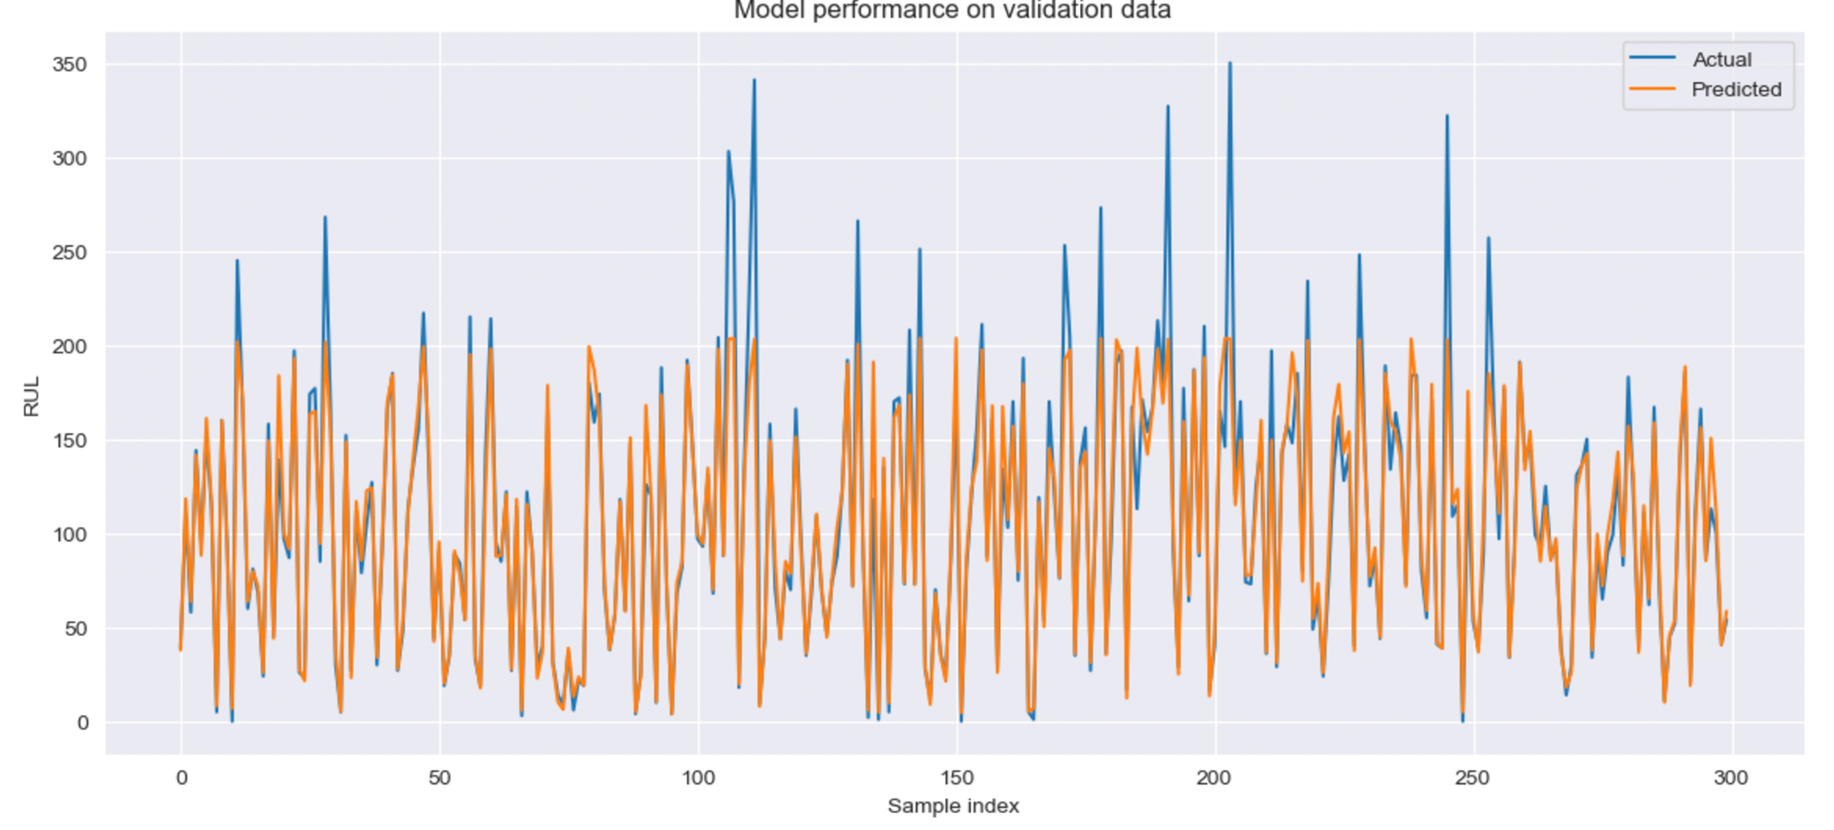

Slide 21
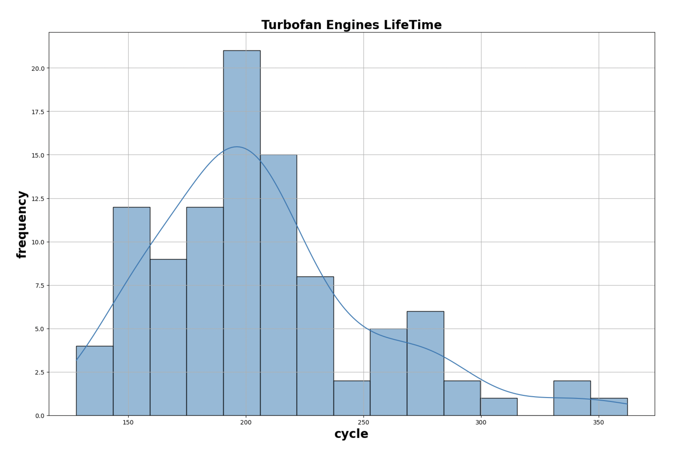

Slide 22
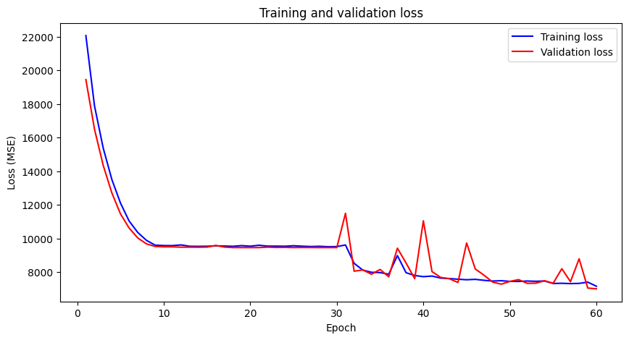

Slide 23
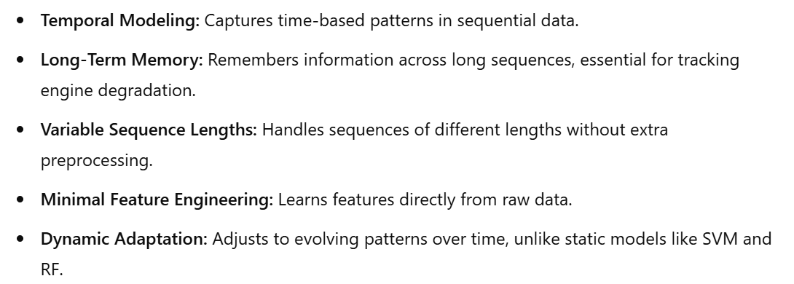
Conclusion- LSTM is the best model

Slide 24
References
1)S. Zheng, K. Ristovski, A. Farahat, and C. Gupta, "Long Short-Term Memory Network for Remaining Useful Life Estimation," 2017 IEEE International Conference on Prognostics and Health Management (ICPHM), 2017, pp. 88-95.
2)Q. Wang, S. Zheng, A. Farahat, S. Serita, and C. Gupta, "Remaining Useful Life Estimation Using Functional Data Analysis," arXiv:1904.06442 [cs.LG], 2019. 3)O. Asif, S. A. Haider, S. R. Naqvi, J. F. W. Zaki, K.-S. Kwak, and S. M. R. Islam, "A Deep Learning Model for Remaining Useful Life Prediction of Aircraft Turbofan Engine on C-MAPSS Dataset," IEEE Access, vol. XX, no. XX, 2022.
4)A. Saxena and K. Goebel, "Turbofan Engine Degradation Simulation Data Set," NASA Ames Research Center, Moffett Field, CA, Tech. Rep. NASA TM-2009-215988, 2008.
5)https://data.nasa.gov/Aerospace/CMAPSS-Jet-Engine-Simulated-Data/ff5v-kuh6

